Slide 1
Python Tutorial Series 2019 Basics 3: Packages, Environments and Python Versions
Bruno C. Quint - bquint@gemini.edu
Kenneth Anderson - kanderso@gemini.edu
SUSD - GEMINI South, La Serena, Chile

Slide 2
Previously...
Basics I
What is Python?
What will you need?
Python as a terminal
Python as a script
Types of variables
class
Basics II
Code Flow
Functions
Classes
Methods
Attributes
Sub-Classes
def
self
if
1.
else
for
[x,y]
"abc"
while

Slide 3
Basics 3 – Table of Contents
(Re)using code
Modules
Packages
Python2 to Python3
External packages
Virtual Environments
Conda and Anaconda
__main__
__init__
setup.py
pip
conda

Slide 4
(Re)using code
modules
#!/usr/bin/env python
""" This module, called my_module.py, contains a function that simulates a six side dice roll """
import random
def roll_dice():
_min = 1
_max = 6
result = random.randint(_min, _max)
return result

Slide 5
(Re)using code
modules
#!/usr/bin/env python
""" This module, called my_module.py, contains a function that simulates a six side dice roll """
import random
def roll_dice():
_min = 1
_max = 6
result = random.randint(_min, _max)
return result
In [1]: import my_module
In [2]: print(my_module.roll_dice())
2
In [3]: print(my_module.roll_dice())
5

Slide 6
(Re)using code
script
#!/usr/bin/env python
""" This module, called my_module.py, contains a function that simulates a six side dice roll """
import random
def roll_dice():
_min = 1
_max = 6
result = random.randint(_min, _max)
return result
print('The dice gave me {}'.format(roll_dice()))

Slide 7
(Re)using code
script
#!/usr/bin/env python
""" This module, called my_module.py, contains a function that simulates a six side dice roll """
import random
def roll_dice():
_min = 1
_max = 6
result = random.randint(_min, _max)
return result
print('The dice gave me {}'.format(roll_dice()))
In [1]: import my_module
The dice gave me 6
In [2]: print(my_module.roll_dice())
3

Slide 8
(Re)using code
Special Variables
Special variables start and end with double underscore
__myvariable__
Stores the name of the scope being run.
__name__
Name of the top level scope in Python
__main__

Slide 9
(Re)using code
Special Variables
Special variables start and end with double underscore
__myvariable__
In [1]: print(__name__)
__main__
In [2]: import my_module
The dice gave me 2
In [3]: print(my_module.__name__)
my_module
Stores the name of the scope being run.
__name__
Name of the top level scope in Python
__main__

Slide 10
(Re)using code
script
#!/usr/bin/env python
""" This module, called my_module.py, contains a function that simulates a six side dice roll """
import random
def roll_dice():
_min = 1
_max = 6
result = random.randint(_min, _max)
return result
print('The dice gave me {}'.format(roll_dice()))

Slide 11
(Re)using code
script
#!/usr/bin/env python
""" This module, called my_module.py, contains a function that simulates a six side dice roll """
import random
def roll_dice():
_min = 1
_max = 6
result = random.randint(_min, _max)
return result
print('Current scope: {}'.format(__name__))
print('The dice gave me {}'.format(roll_dice()))

Slide 12
(Re)using code
script
#!/usr/bin/env python
""" This module, called my_module.py, contains a function that simulates a six side dice roll """
import random
def roll_dice():
_min = 1
_max = 6
result = random.randint(_min, _max)
return result
print('Current scope: {}'.format(__name__))
print('The dice gave me {}'.format(roll_dice()))
$ python my_module.py
Current scope: __main__
The dice gave me 1

Slide 13
(Re)using code
script
#!/usr/bin/env python
""" This module, called my_module.py, contains a function that simulates a six side dice roll """
import random
def roll_dice():
_min = 1
_max = 6
result = random.randint(_min, _max)
return result
if __name__ == '__main__':
print('The dice gave me {}'.format(roll_dice()))

Slide 14
(Re)using code
script
#!/usr/bin/env python
""" This module, called my_module.py, contains a function that simulates a six side dice roll ""”
import random
def roll_dice():
_min = 1
_max = 6
result = random.randint(_min, _max)
return result
if __name__ == '__main__':
print('The dice gave me {}'.format(roll_dice()))
In [1]: import my_module
In [2]: print(my_module.roll_dice())
4

Slide 15
(Re)using code
good practice
#!/usr/bin/env python
""" This module, called my_module.py, contains a function that simulates a six side dice roll """
import random
def roll_dice():
_min = 1
_max = 6
result = random.randint(_min, _max)
return result
if __name__ == '__main__':
print('The dice gave me {}'.format(roll_dice()))

Slide 16
(Re)using code
good practice
#!/usr/bin/env python
""" This module, called my_module.py, contains a function that simulates a six side dice roll """
import random
def main():
print('The dice gave me {}'.format(roll_dice()))
def roll_dice():
_min = 1
_max = 6
result = random.randint(_min, _max)
return result
if __name__ == '__main__':
main()

Slide 17
(Re)using code
packages
my_project/

Slide 18
(Re)using code
packages
my_project/
my_package/

Slide 19
(Re)using code
packages
my_project/
my_package/
__init__.py

Slide 20
(Re)using code
packages
my_project/
my_package/
__init__.py
first_module.py
second_module.py

Slide 21
(Re)using code
packages
my_project/
my_package/
__init__.py
first_module.py
second_module.py
In [1]: import my_package
In [2]: my_package.first_module.my_function()
In [1]: from my_package import first_module
In [2]: first_module.my_function()

Slide 22
(Re)using code
packages
my_project/
my_package/
__init__.py
first_module.py
second_module.py
my_subpackage/
__init__.py
...

Slide 23
(Re)using code
packages
my_project/
my_package/
__init__.py
first_module.py
second_module.py
my_subpackage/
__init__.py
...
setup.py
README
LICENSE
requirements.txt
.gitignore

Slide 24
(Re)using code
packages
my_project/
my_package/
__init__.py
first_module.py
second_module.py
...
docs/
tests/
bin/
setup.py
README
LICENSE
requirements.txt
.gitignore

Slide 25
(Re)using code
packages
my_project/
my_package/
__init__.py
setup.py
first_module.py
second_module.py
$ python setup.py install
my_subpackage/
__init__.py
...
setup.py
README
LICENSE
requirements.txt
.gitignore

Slide 26
(Re)using code
packages
my_project/
my_package/
__init__.py
setup.py
first_module.py
second_module.py
$ python setup.py install
my_subpackage/
__init__.py
pip
...
setup.py
README
LICENSE
$ pip install .
requirements.txt
.gitignore

Slide 27
(Re)using code
packages
my_project/
my_package/
__init__.py
setup.py
first_module.py
second_module.py
$ python setup.py install
my_subpackage/
__init__.py
pip
...
setup.py
README
LICENSE
$ pip install .
$ pip install –e .
editable
requirements.txt
.gitignore
good for development

Slide 28
(Re)using code
packages
my_project/
my_package/
__init__.py
setup.py
first_module.py
second_module.py
$ python setup.py install
my_subpackage/
__init__.py
pip
...
setup.py
README
LICENSE
$ pip install .
$ pip install –e .
requirements.txt
$ pip --help
.gitignore

Slide 29
Py2/3 Conversion
With Python 2.x EoS slated for end of this year (2019), it is becoming increasingly important to move existing code to Python 3. There are some big differences between Python 2.x and Python 3.x., but there are resources available to help developers move to Py3.
2to3 – available directly with your Py3 conda environment.
$ which 2to3
~/anaconda2/envs/dragons36/bin/2to3
Porting Code to Python 3 with 2to3 (Dive into Python).
https://www.diveinto.org/python3/porting-code-to-python-3-with-2to3.html
Python docs also provides help on 2to3.https://docs.python.org/3.7/library/2to3.html

Slide 30
Py2/3 Conversion
Things to be prepared for:
print statement – not a “statement” but now a function.
e.g., print “foo”, “bar” ➔ print(“foo”, “bar”)
strings – Py2: unicode, string, and byte
Py3: unicode, byte (all strings in Py3 are unicode).
long int – Py2 only. There is only one int type in Py3.
dict – Py3, methods on dictionaries return “views”, which are
not usually what you want. To maintain the iterator
behaviour of .items(), .values(), etc., methods just
wrap in a list.
a_dict.keys() ➔ list(a_dict.keys())

Slide 31
Py2/3 Conversion
Python 2>3 (cont’d)
More on dict types – method .has_key() is gone on Py3. Use nominal
Python idiom “in”. E.g.,
a_dict.has_key(‘foobar’) ➔ ‘foobar’ in a_dict
In Python 3, several modules have been reorganized, and/or elinminated.
Notables:
http libraries
urllib libraries
(dbm libraries)
For example,
urlparse ➔ urllib.parse
Py2 division is replaced. Use “//” for integer division. “/” is purely float div.
py2: 1/3 ➔ 0
py3: 1/3 ➔ 0.3333333… 1//3 ➔ 0

Slide 32
Py2/3 Conversion
Demo Time
Run 2to3 against some existing scripts.

Slide 33
External Packages
pip
https://pypi.org/
Default package manager
$ pip --help
Search
$ pip search <package_name>
Install
List
$ pip install scipy
$ pip list
Upgrade
Uninstall
$ pip install scipy --upgrade
$ pip uninstall pyfits

Slide 34
Virtual Environments
1
users
user_1
user_2
user_3
system
/usr/bin/python

Slide 35
Virtual Environments
1
users
venv
user_1
user_2
user_3
system
/usr/bin/python

Slide 36
Virtual Environments
1
2
users
py36
venv
user_1
user_2
user_3
system
/usr/bin/python

Slide 37
Virtual Environments
1
2
3
users
py36
py27
venv
user_1
user_2
user_3
system
/usr/bin/python

Slide 38
Virtual Environments
1
2
3
users
py36
py27
venv
user_1
user_2
user_3
system
/usr/bin/python

Slide 39
Conda and Anaconda

Slide 40
Conda and Anaconda
MINI

Slide 41
Conda and Anaconda
MINI

Slide 42
Conda and Anaconda
MINI
Command line virtual environment and package manager

Slide 43
Conda and Anaconda
MINI
= conda
+ base environment
+ python
+ base packages
Command line virtual environment and package manager

Slide 44
Conda and Anaconda
MINI
= miniconda
+ more than 100 packages
= conda
+ base environment
+ python
+ base packages
Command line virtual environment and package manager

Slide 45
Virtual Environments
1
2
3
4
users
py36
py27
anaconda
venv
venv
user_1
user_2
user_3
system
/usr/bin/python

Slide 46
Virtual Environments
1
2
3
4
5
users
py27
py36
py27
anaconda
venv
venv
user_1
user_2
user_3
system
/usr/bin/python

Slide 47
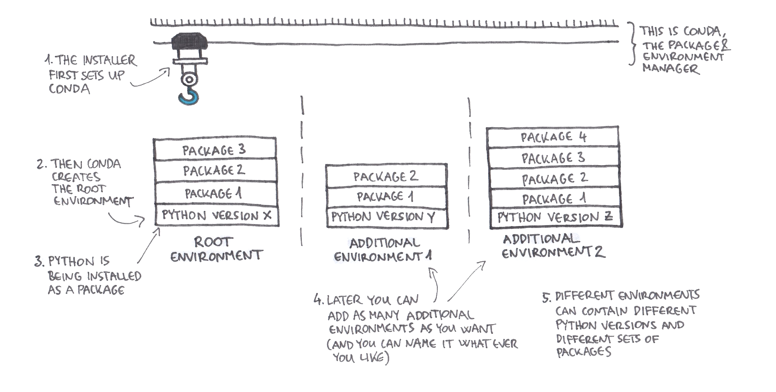
Conda and Anaconda
Base
environment

Slide 48
Conda and Anaconda
Download and Install
MINI
Download and Install

Slide 49
Conda and Anaconda
Let’s check which Python we are using.
$ which python
/usr/bin/python
System
$ which python
/Users/<user>/miniconda3/bin/python
Miniconda
$ which python
/home/<user>/miniconda3/bin/python
$ which python
/Users/<user>/anaconda3/bin/python
Anaconda
$ which python
/home/<user>/anaconda3/bin/python

Slide 50
Conda and Anaconda
HELP!!!
$ conda help
usage: conda [-h] [-V] command ...
...
...
...

Slide 51
Conda and Anaconda
HELP!!!
$ conda help
usage: conda [-h] [-V] command ...
...
...
...
info
create
activate
list
remove
deactivate

Slide 52
Conda and Anaconda
HELP!!!
$ conda help
usage: conda [-h] [-V] command ...
...
...
...
info
create
activate
list
remove
deactivate
$ conda create --help

Slide 53
Conda and Anaconda
Manage Packages
Search
$ conda search <package_name>
Install
$ conda install --channel astroconda sextractor
$ conda install ds9=7.5
List
$ conda list
$ conda list --explicit > list_of_packages.txt
Remove
Update
$ conda remove seaborn
$ conda update numpy

Slide 54
Conda and Anaconda
Manage Environments
Create
$ conda create --name myenv --python=3.6 pkg1 pkg2 pkg3 ...
$ conda create -n myenv --file list_of_packages.txt
(De)Activate
Conda >= 4.6
$ source activate myenv
$ conda activate myenv
$ source deactivate
$ conda deactivate
List enviroments
Remove
$ conda info --envs
$ conda remove --name myenv --all

Slide 55
Conda and Anaconda
HELP!!!
$ conda help
usage: conda [-h] [-V] command ...
...
...
...
conda commands available from other packages:
env

Slide 56
Conda and Anaconda
HELP!!!
$ conda help
usage: conda [-h] [-V] command ...
...
...
...
conda commands available from other packages:
env

Slide 57
Conda and Anaconda
HELP!!!
$ conda help
usage: conda [-h] [-V] command ...
...
...
...
conda commands available from other packages:
env
$ conda list
$ conda remove -n myenv --all
!=
!=
$ conda env list
$ conda env remove -n myenv

Slide 58
Conda and Anaconda
HELP!!!
$ conda help
usage: conda [-h] [-V] command ...
...
...
...
conda commands available from other packages:
env
$ conda list
$ conda remove -n myenv --all
!=
!=
$ conda env list
$ conda env remove -n myenv
conda vs conda env has too much confusion #5253

Slide 59
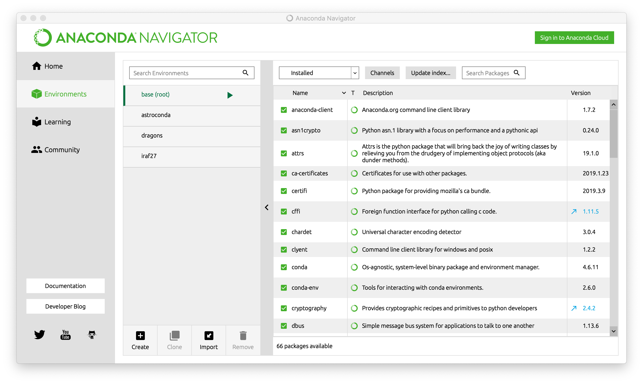
Conda and Anaconda
Manage Environments

Slide 60
Conda and Anaconda
Manage Environments

Slide 61
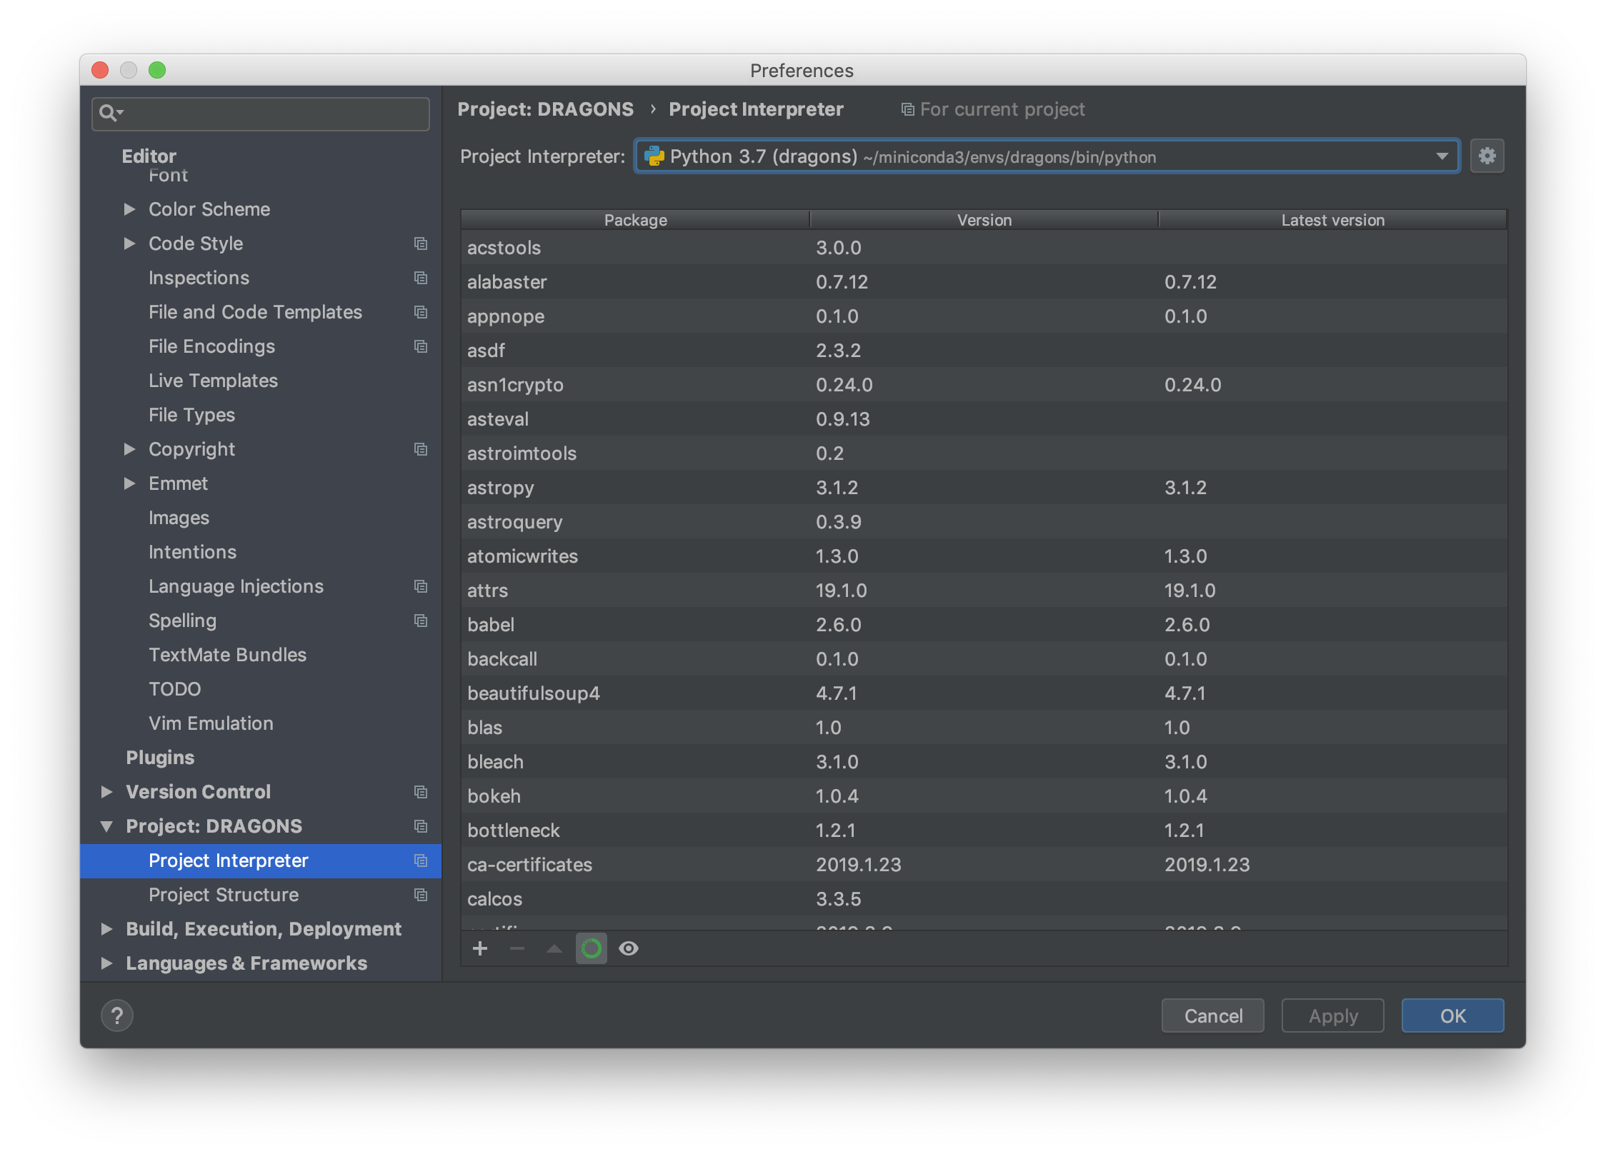
Conda and Anaconda
Manage Environments

Slide 62
Now what?
The Exercise 3 holds a simple example of a Python Project. It includes three Python files:
my_module.py that can be invoked from a terminal and return a random value between 1 and 6,
dices.py that contains classes with dices,
setup.py which contains the configuration for installation of the package.
Exercise
Check the GitHub Page with the exercises:
https://github.com/b1quint/Python-Tutorial-Series/tree/master/Exercises

Slide 63

Questions?

